Slide 1

Session 2: Automating Tasks Using PowerShell and Community Modules
Introduction to using PowerShell and community modules like dbatools, dbachecks, and ImportExcel to automate and simplify tasks in SQL Server.

Slide 2






What is PowerShell?
2006
2012
Mar 2020
PowerShell 1.0 released by Microsoft
PowerShell 3.0 adds many new features and capabilities
PowerShell 7.0 released - based on .NET Core 3.1
2008
2018
Nov 2020
PowerShell integrated into Windows Server 2008
PowerShell made open-source and cross-platform with version 6.0
PowerShell 7.1 released - based on .NET 5

Slide 3
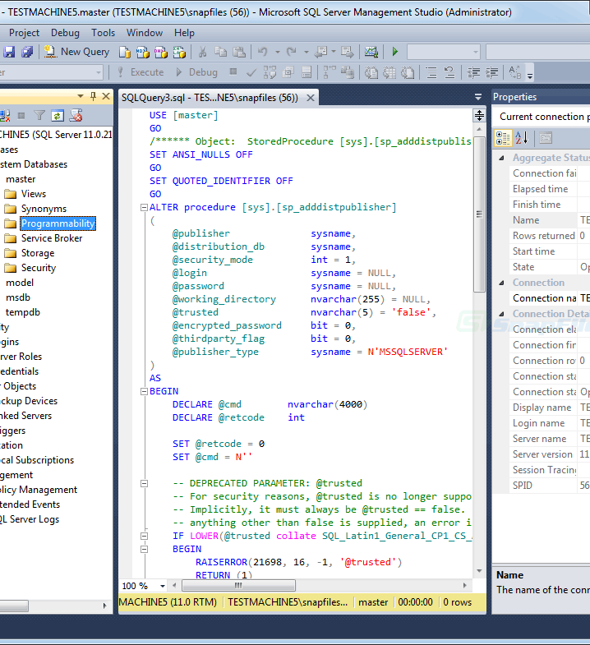
PowerShell for SQL Server
PowerShell provides a powerful CLI to automate administration tasks.
Community modules can be installed to add additional functionality.

Slide 4
Introduction to Community Modules
What are Community Modules?
Why Use Community Modules?
Popular Modules
Community modules are open-source PowerShell modules created by the community to simplify management tasks.
Community modules help automate repetitive tasks, implement best practices, and reduce errors compared to manual processes.
Some popular community modules for SQL Server are, dbatools, dbachecks. Other useful ones include Pester ,ImportExcel, and dbaclone.
Key Benefits
How To Get Them
Community modules enhance productivity, enable collaboration, and provide access to scripts developed by experts.
Modules can be installed from the PowerShell Gallery and GitHub repositories published by community members.

Slide 5
dbatools: A Deep Dive
Introduction to dbatools
Brief overview of dbatools - its purpose, key features, community etc.
Basic Commands
Show examples of basic dbatools commands like Get-DbaDatabase, Test-DbaConnection etc.
Backup and Restore
Demonstrate backup and restore workflows using dbatools cmdlets.
Instance Migrations
Show how to use dbatools for migrating SQL instances and databases.
Community Tools Management
Installing community tools such as Ola Halllengren Maintenance Solution and, Adam Machanic’s sp_whoisactive
Configuration Changes
Automate configuration changes on SQL instances using dbatools.
Real-World Examples
Share real-world examples/scenarios where dbatools was used to automate tasks.

Slide 6
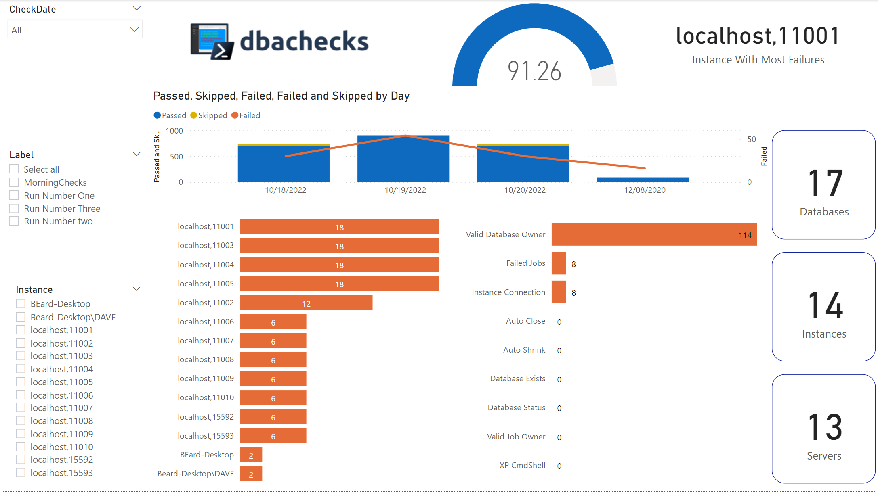
dbachecks
Overview of dbachecks functionality
Running database checks
Storing dbachecks data
PowerBI Dashboard

Slide 7





ImportExcel: Example
Feature
Description
Import from Excel
Easily import Excel data into SQL Server tables using the ImportExcel module
Export to Excel
Export SQL Server data to Excel spreadsheets for reporting and analysis
Notes:
Invoke-DbaAzSqlDbTip - example

Slide 8
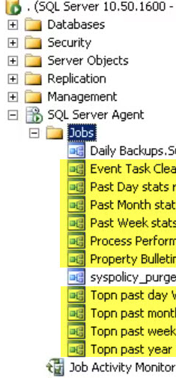
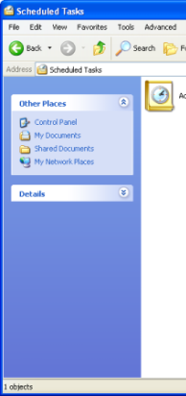
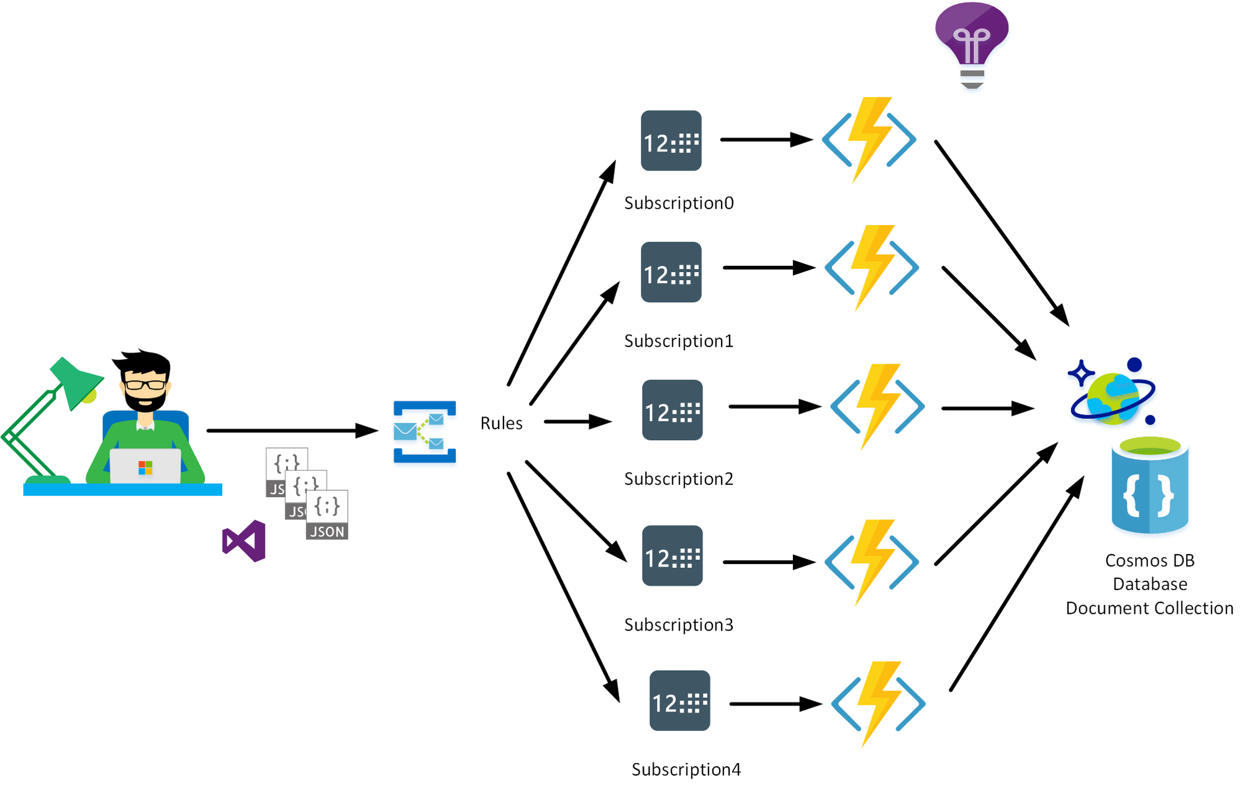


Automating Routine Tasks
SQL Agent Jobs
Scheduled Tasks
Azure Functions
Azure Automation
Enterprise Schedulers

Slide 9
If we have time
What are some key things to remember when getting started with PowerShell?
Where can I find useful example scripts for automation?
How do I decide which community module to use for a task?
What are some best practices for PowerShell automation scripts?
Are there any pitfalls to be aware of when automating SQL Server tasks?
Notes:
??

Slide 10

LUNCH

Slide 11

Come back at:
00:00
Notes:
Add a timer? Or agenda here

